Slide 1
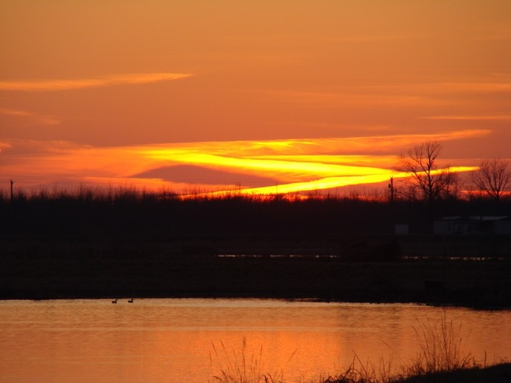
USGS Science to Inform Management of Wildlife Diseases Shared with Agricultural Animals
May 21, 2024
GEERU Workshop
M. Camille Hopkins DVM, MS, PhD, Dipl. ACVPM
USGS Ecosystems Mission Area
www.usgs.gov/ecosystems
Coldwater River NWR, MS
Credit: B.M.Glorioso
Notes:
Good Morning (CLICK!), Here you can see a beautiful sunset at Coldwater River NWR south of Crowder MS. This refuge is critically important as a sanctuary for waterfowl and neotropical migratory birds. Unfortunately, over the last few years wild birds and mammals have been impacted by the highly pathogenic avian influenza panzootic (global animal disease outbreak). Since at least 2006, DOI (esp, USFWS and USGS) have partnered with USDA/APHIS/WS for avian influenza surveillance in wild birds.
Photo Credit: www.louisianaherps.com/scenery/coldwater-river-nwr-ms.html
What kind of research is the USGS doing to understand animal diseases that harms livestock and farming communities in my district?
Native fish and wildlife biodiversity is declining in the face of multiple stressors, including infectious diseases. Some of those diseases are at the interface with the U.S. agriculture industry like avian influenza and others that affect public health like COVID-19. A USDA study confirmed that 79% of livestock diseases in the US are shared with wildlife.
USGS collaborates with USDA/APHIS/Wildlife Services on other diseases of farmed animals including chronic wasting disease that also affects wild deer and elk; bovine brucellosis that is found in elk and bison; bat rabies (bat rabies vaccine developed); diseases affecting wild fish and aquaculture; rabbit hemorrhagic disease; and antimicrobial resistance in wildlife and the environment.
In 2022, USGS published results of a Central Valley of CA waterfowl movement study that provided first-time evidence that wild birds (e.g., mallards) do go onto dairy operations in addition to poultry facilities.
In 2024, USGS published results of a Delmarva Peninsula (Delaware, MD, VA) study that found that there is high use of farm stormwater retention ponds near poultry operations by waterfowl, indicating a risk for avian influenza spread. Preliminary results suggested that vegetation management techniques around those ponds may reduce the risk of avian influenza.
A 2020 USGS study found that infectious avian influenza virus can persist in northern wetlands (MN, AK) for more than 7 months. USGS developed a field test for avian influenza in water and worked with CDC to confirm during this current US outbreak that infectious AI was found in four Iowa wetlands.

Slide 2
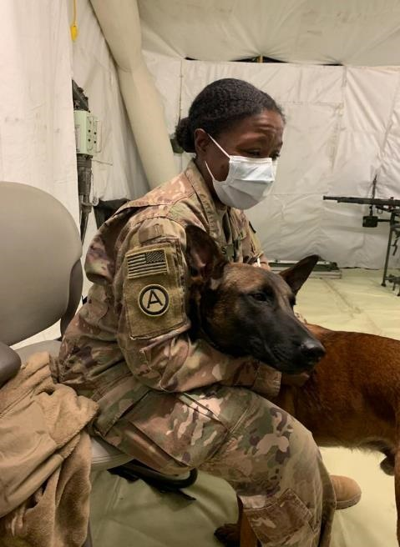
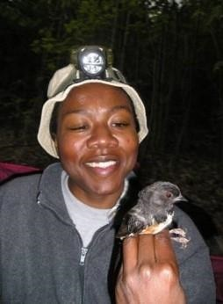
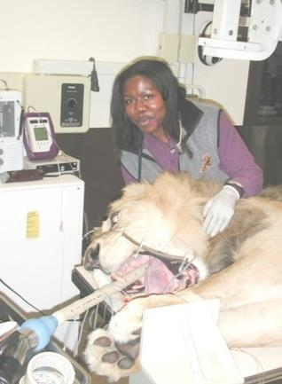
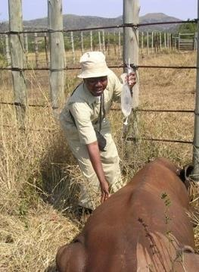



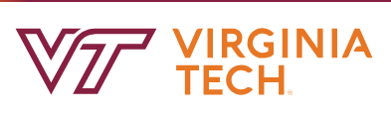
Republic of South Africa private game reserve. After game auction purchase, post-travel IV fluids were administered to this baby rhino (Ceratotherium simum).
Eastern Towhee (Pipilo erythrophthalmus) in hand after mist-netting in Jefferson National Forest, Virginia
US Army Veterinary Corps
CENTCOM
Operation Inherent Resolve, Iraq
Examination of a lion (Panthera leo) at Smithsonian’s National Zoo
Wildlife Veterinarian, Disease Ecologist, Army Veteran
DVM and MS (Wildlife Population Medicine)
B.S. Biology (Animal Physiology)
PhD (Biology, Disease Ecology)
SVM Caucus 20231212
Notes:
I’m based at USGS HQ in Reston, VA where I serve as the wildlife disease coordinator in the Office of the Associate Director for Ecosystems. From HQ, I make recommendations for budget planning, strategic planning, and science driven by stakeholder needs for our national aquatic (freshwater, marine) and terrestrial wildlife disease portfolio. A USDA-CEAH (Centers for Epidemiology and Animal Health) study found that 79% of livestock diseases in the US are shared with wildlife. USGS has strong collaborations with USDA on some of these diseases. As a DOI bureau, we are also vested in the perceived or real food safety concerns of subsistence hunters, anglers, gatherers, and Tribal Nations.

Slide 3

Presentation Outline
US Geological Survey Introduction
Shared Terrestrial Diseases
Shared Aquatic Diseases
GEERU 20240521
Notes:
In this presentation, I’ll first introduce my agency (CLICK!) and then highlight a terrestrial and aquatic example of USGS science on wildlife diseases shared with agricultural animals. Interspersed will be discussion points on opportunities for future ARS-USGS collaborations.

Slide 4
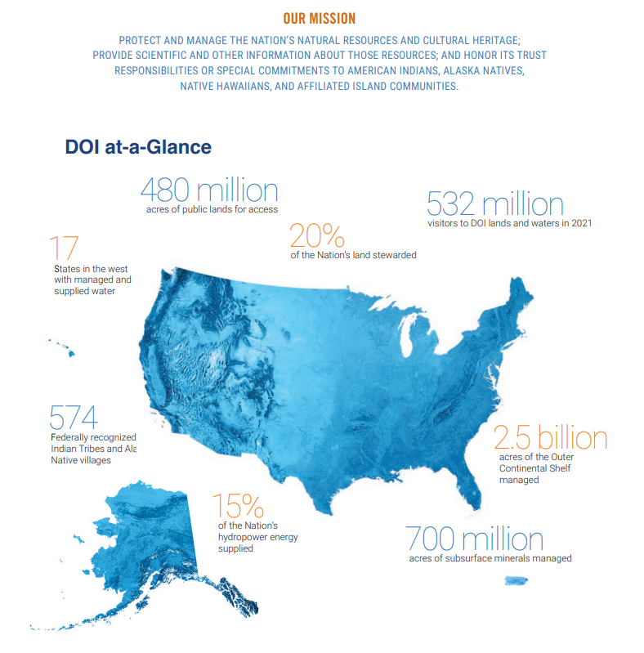
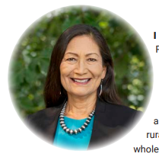
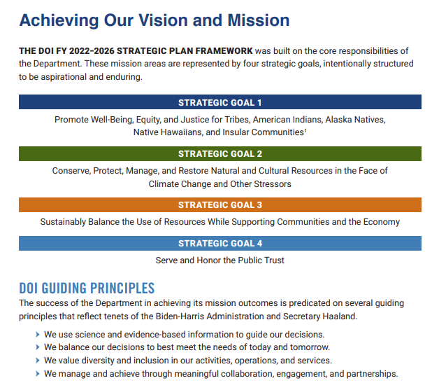
GEERU 20240521
Notes:
Here you can see a photo of Sec. Haaland, an infographic on the Department of the Interior, our goals, and guiding principles. For USGS Ecosystems our work primarily fits under Goal 2 – science to support efforts to conserve, protect, manage, and restore natural and cultural resources in the face of climate change and other stressors.
In this presentation, I’ll first introduce my agency (CLICK!), highlight terrestrial and aquatic examples of USGS science on wildlife diseases shared with agricultural animals. Then close with opportunities for future ARS-USGS collaborations.

Slide 5
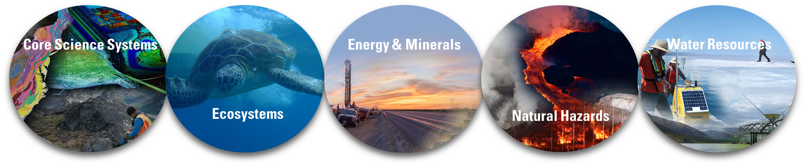
U.S. Geological Survey Mission Areas
Civilian mapping agency for the Nation
Science to support management and conservation of natural resources​
Research and assessments that focus on the location, quantity, and quality of mineral and energy resources
Monitor, assess, and conduct targeted research on a wide range of natural hazards
​
Monitor, assess, conduct targeted research, and deliver information on a wide range of water resources
GEERU 20240521
Notes:
USGS is the Science Agency for the Department of the Interior. We do not have management or regulatory responsibility, which allows us to provide unbiased science to support natural resource management. Here you can see the five mission areas of USGS. Our wildlife disease portfolio is in the Ecosystems Mission Area.

Slide 6

USGS Ecosystems Mission Area Ecosystem science is the study of systems of organisms interacting with their environment and the consequences of natural and human-induced change on those systems
Ecosystems
Cooperative Research Units
Climate Adaptation Science Centers & Land Change Science
Land Change Science (Climate Research & Development)
42 Units in 40 States
National & Regional Climate Adaptation Science Centers
Environmental Health
Contaminant Biology
Toxic Substances Hydrology
Species Management
Terrestrial Species Research
Fish and Aquatic Species Research
Technology Advances, Species Identification & Tracking
Land Management
Priority Landscapes
Management & Restoration
Biological Threats and Invasive Species
Fish & Wildlife Disease
Invasive Species
Wildland Fire
GEERU 20240521
Notes:
Ecosystems is the largest mission area in USGS with a diverse scientific portfolio. We conduct applied ecological science to inform natural resource management in our changing world. Disturbances, including wildlife diseases and invasive species, can impact ecosystem health and resilience.

Slide 7
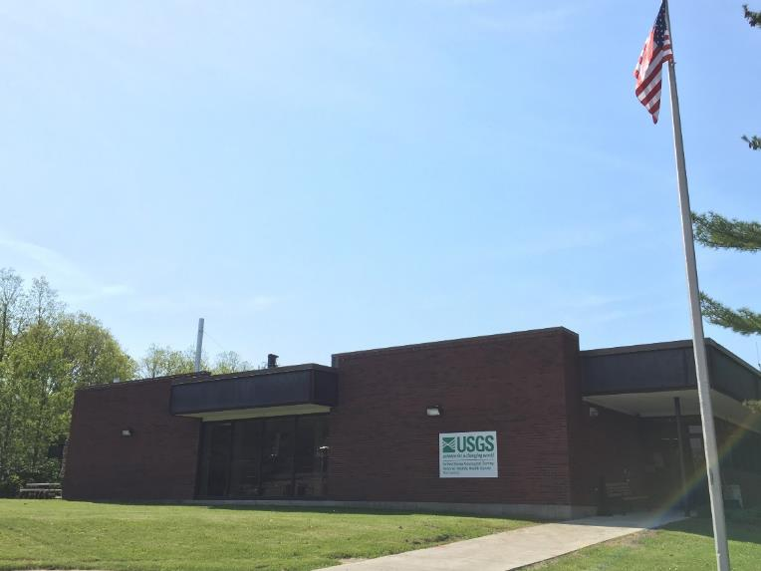
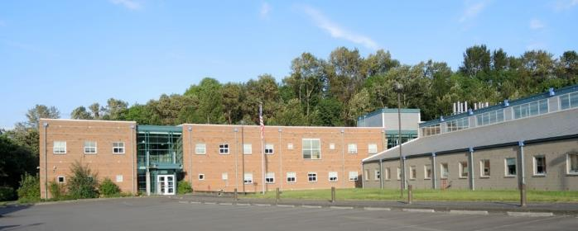
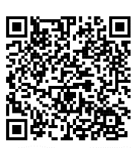
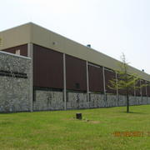
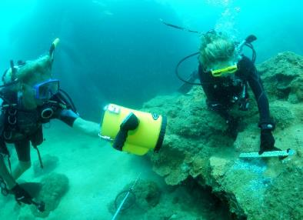
Wildlife Cause-of-Death Investigations
USGS leads investigations of unusual morbidity and mortality events in aquatic and terrestrial wildlife across the nation
Western Fisheries Research Center (Washington)
Eastern Ecological Science Center
(West Virginia & Maryland)
National Wildlife Health Center (Wisconsin)
National Wildlife Health Center – Honolulu Field Station (Hawaii)
GEERU 20240521
Notes:
USGS maintains diagnostic and research facilities to conduct aquatic and terrestrial cause-of-death investigations. These often serve as the impetus for applied research to reduce uncertainty and identify management options to support wildlife health and resilience. In addition to this passive disease-agnostic surveillance, USGS often conducts active disease surveillance that is incorporated into larger ecological research projects.
-------------------------

Slide 8
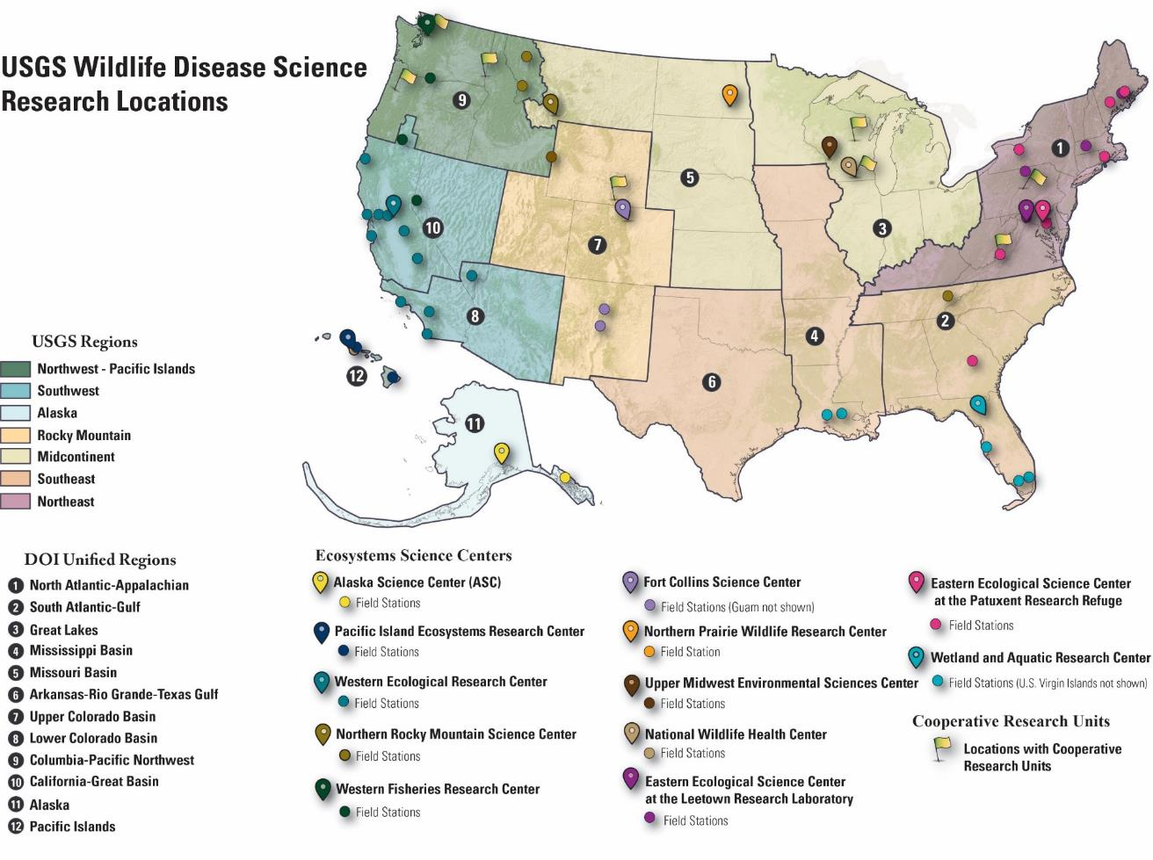
GEERU 20240521
Notes:
USGS’s wildlife disease expertise veterinarians and ecologists at federal science centers (like our National Wildlife Health Center) but also USGS scientists who are embedded as professors at land-grant universities to conduct research that aligns with state wildlife agency priorities and train the next generation of wildlife biologists at Cooperative Research Units (like the CRU here at Mississippi State).

Slide 9
Wildlife Disease Ecology
Fischhoff et al. 2020. Ecosphere 11(5), p.e03057
GEERU 20240521
Notes:
As a disease ecologist, I recognize that pathogens and parasites are part of ecosystems. However, there are those that can directly (CLICK!) or indirectly impact ecosystem processes. They may impact wildlife phenotype (CLICK!) [the observable physical properties of an organism like behavior] or the abundance or biomass of species and ecological communities.

Slide 10
Presentation Outline
US Geological Survey Introduction
Shared Terrestrial Diseases
Shared Aquatic Diseases
Miller et al. 2013 Prev Vet Med 110:119-132
GEERU 20240521
Notes:
CLICK! CLICK! This table from Miller et al. 2013 highlights several managed livestock diseases including those that also circulate in wildlife. USGS has collaborated with USDA on science to better understand, detect, and respond to these diseases.
(Miller, R. S., M. L. Farnsworth, and J. L. Malmberg. 2013. Diseases at the livestock– wildlife interface: status, challenges, and opportunities in the United States. Preventive Veterinary Medicine 110:119–132

Slide 11

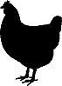
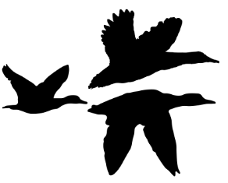

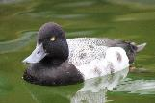

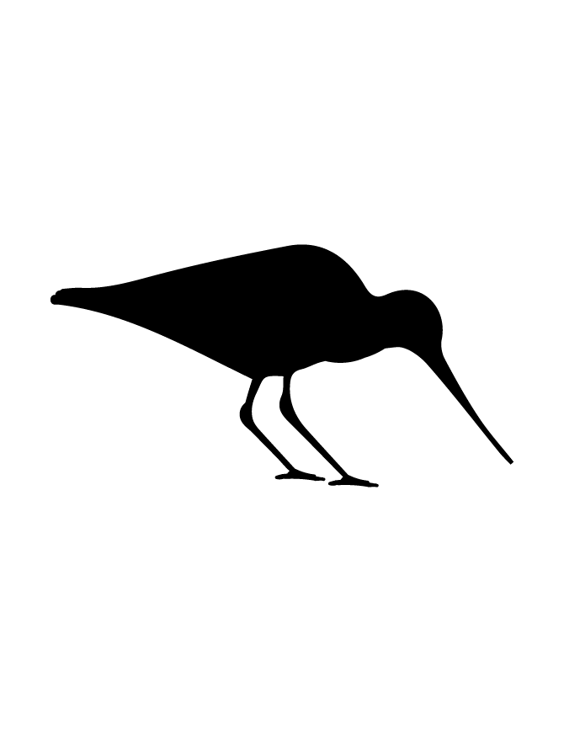

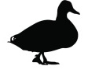

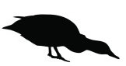

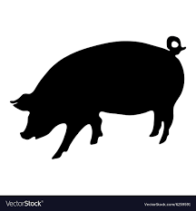
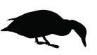
Ecology of Avian Influenza (AI) Viruses
IAVs may adapt to and be maintained among domestic poultry.
Influenza A viruses (IAVs) are maintained in aquatic wild birds.
IAVs maintained in wild birds periodically spillover into domestic poultry.
x
IAVs deposited into the environment may remain infectious for extended periods.
x
IAVs of the H5 or H7 subtype may develop high pathogenicity in gallinaceous poultry.
IAVs of wild bird ancestral origin infrequently spillover from domestic poultry to humans or swine and may cause disease.
Lesser Scaup
(Aythya affinis)
Susceptible birds are exposed to IAVs through foraging or preening.
IAVs in wild birds periodically spillover into mammals.
x
In relatively rare instances, highly pathogenic IAVs spillback from domestic poultry into wild birds, causing disease. Asymptomatic infections may also occur, facilitating further spread.
IAVs adapted to, maintained within, and spread between humans and swine have been identified as having wild bird ancestral origins.
Credit: Andy Ramey, USGS Alaska Science Center
GEERU 20240521
Notes:
For example, USGS science has contributed to a paradigm shift in our understanding of avian influenza dynamics. (CLICK!) I want to highlight four key points from this complex image:
(red arrow) The key paradigm shift is bidirectional virus exchange - Highly pathogenic viruses in poultry can spill back into wild birds, resulting in further geographic spread through migration (and adaptation) of the virus
(red text) Virus in the environment may remain infectious for extended periods and USGS has developed methods to detect infectious AI in surface waters.
(blue arrow and blue fox). AI in wild birds periodically spills over into mammals
(Photo of lesser scaup). Collaborating with SEPRL in a 2017 publication, USGS found that diving ducks can become infected and shed HPAI. Then in 2022, For the first time, our scientists tracked the movement of a lesser scaup known to be infected with highly pathogenic avian influenza in North America.

Slide 12
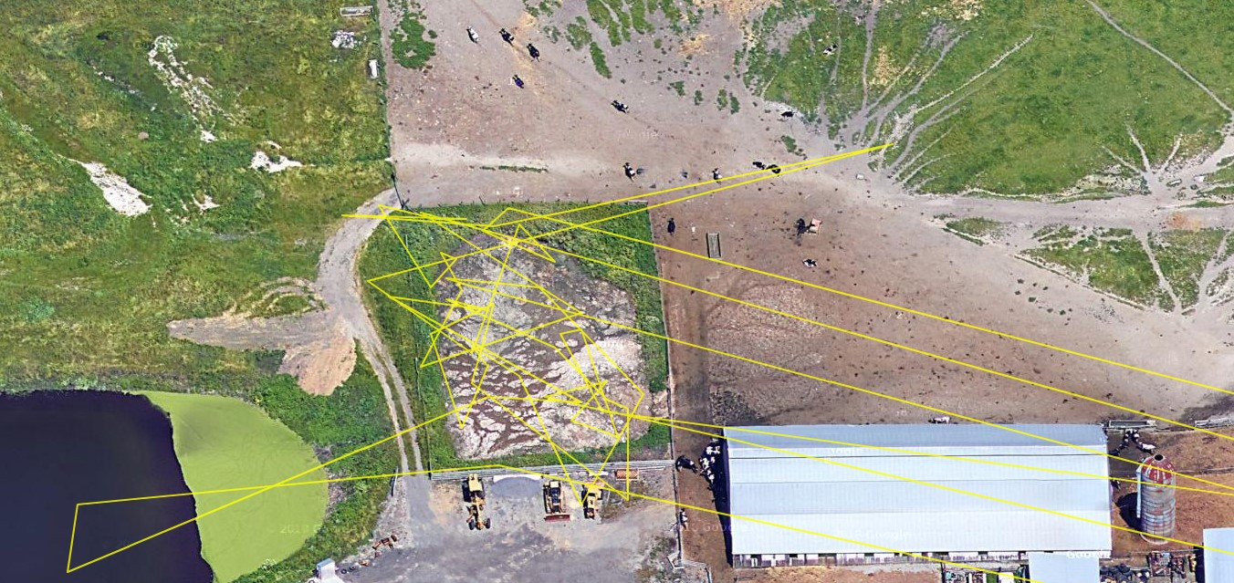
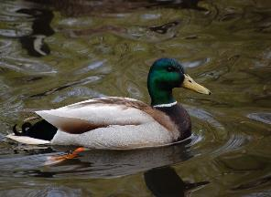
Mallard
(Anas platyrhynchos)
This information is preliminary and is subject to revision. It is being provided to meet the need for timely best science. The information is provided on the condition that neither the U.S. Geological Survey nor the U.S. Government shall be held liable for any damages resulting from the authorized or unauthorized use of the information.
Image Credit: M. Casazza Mike_Casazza@usgs.gov
Notes:
Can anyone tell us what type of facility this is? Yes, dairy. Here you can see in yellow the movements of a mallard duck on and near a dairy operation in California. This GPS telemetry data was captured last month by USGS scientists. This builds off of past evidence from USGS (CLICK!)

Slide 13
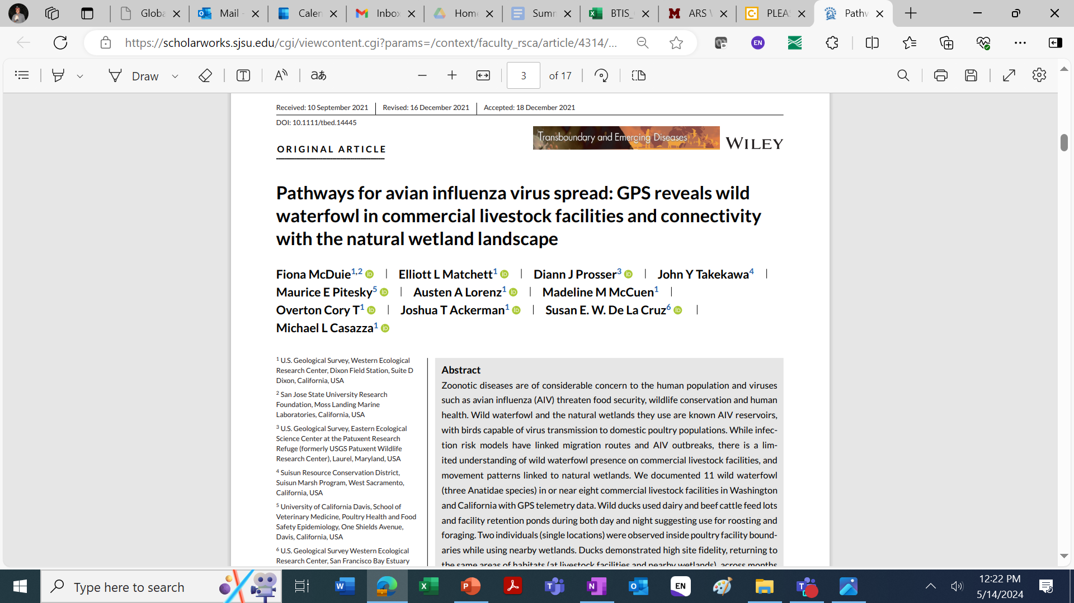
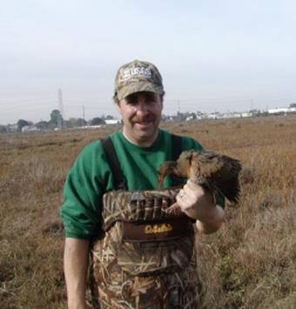
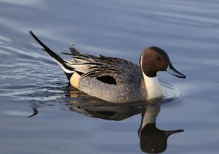
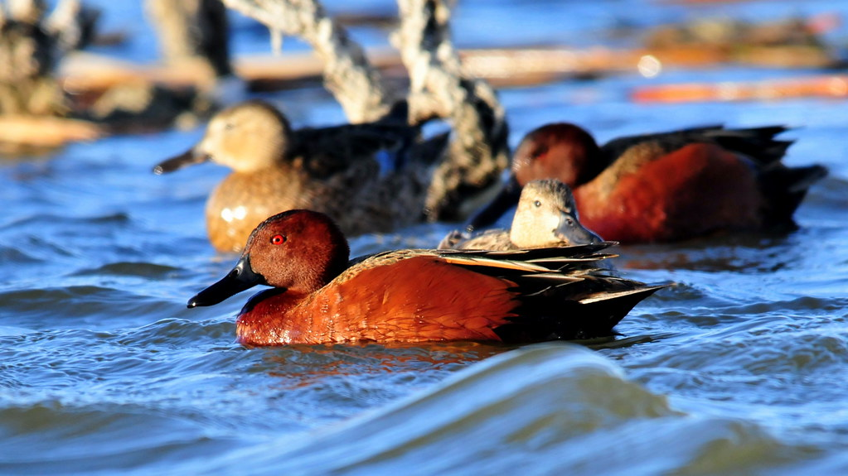
Michael Casazza M.S.
USGS Western Ecological Science Center
Mike_Casazza@usgs.gov
Northern pintail
(Anas acuta)
Cinnamon Teal (Spatula cyanoptera)
Credit: USFWS, Tom Koerner
Mallard
(Anas platyrhynchos)
Notes:
A 2022 USGS pub included first-time GPS evidence that wild birds (mallard, northern pintail, and cinnamon teal) do go onto dairy operations (in addition to poultry facilities). This study also noted that this sometimes included the use of stormwater retention ponds.

Slide 14
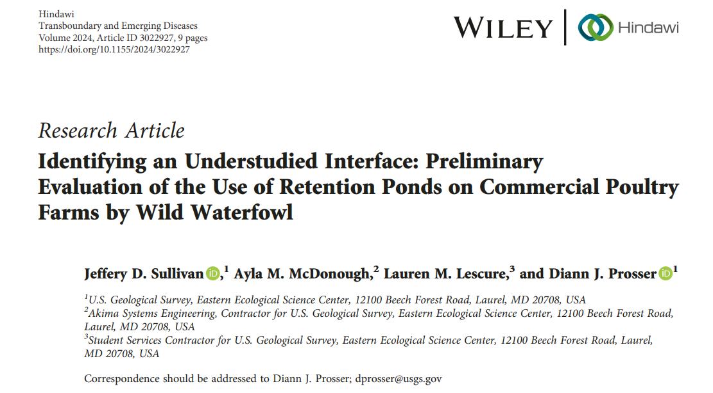
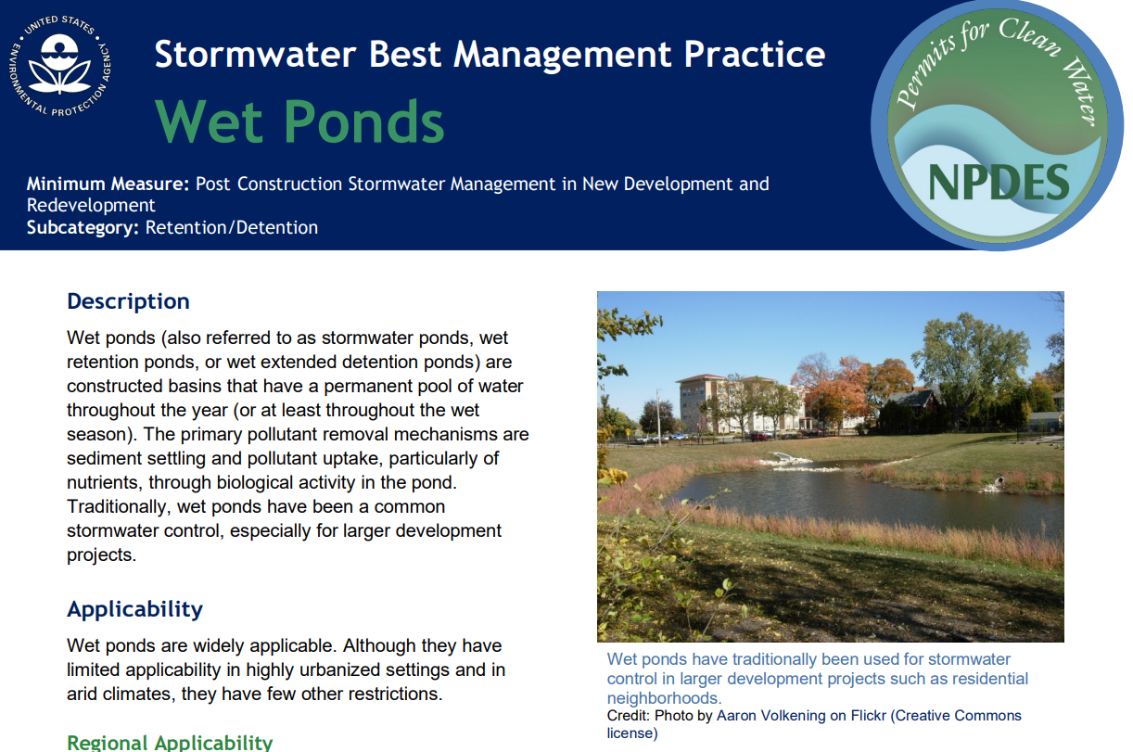
GEERU 20240521
Notes:
In EPA’s stormwater BMPs, they highlight wet ponds for stormwater control. A 2024 USGS pub describes wild bird use of retention ponds on poultry operations in the Delmarva Peninsula. Using 6 months of data, they found that several wild bird species used retention ponds. More research is needed but two key findings: (1) Temporal trends aligned with migratory pulses in local wild bird abundance and (2) wild bird use appeared to be related to vegetation surrounding ponds. Most waterfowl preferred open habitat with sparse vegetation with the exception being our state duck – wood ducks – that preferred tree-dominated sites. So vegetation management might help reduce the risk of avian influenza spread through this interface.
[ten species of waterfowl as well as Great Blue Herons and BAEAs used the ponds.
- Temporal trends aligned with migratory pulses in local abundance (rather than just resident species). For example, in MD peak mallard and Canada geese numbers were observed in Dec and Jan.
- Vegetation immediately surrounding the ponds. “Our data align with previous USFWS research that suggests waterbodies buffered by dense stands of tall, emergent vegetation demonstrate decreased use by waterfowl, whereas waterbodies that are sparsely vegetated with shorter emergent vegetation in a more open wetland habitat depict increased utilization by wild waterfowl [43].” The only exception was MS’s state duck – Wood ducks preferred tree-dominated sites, which fits with their breeding ecology.
--
TABLE 1: A summary of waterfowl observed on retention ponds associated with commercial poultry farms in Dorchester and Somerset counties, Maryland, from 20 September 2022 to 31 March 2023. Species Sites observed Max observed Blue-winged teal 2 2 Bufflehead 2 14 Canada goose 6 132 Gadwall 1 1 Hooded merganser 3 12 Mallard 4 16 Northern pintail 1 5 Northern shoveler 2 3 Ruddy duck 1 20 Wood duck 3 2 Values indicate the number of sites at which a given species was observed and the maximum number of individuals from that species observed during a single survey. All data supporting this figure are available from
Not surprisingly, Canada geese were most frequently observed. There were confounding factors but preliminary data suggested ponds with open vegetation had the most species as well as the highest when compared to tree dominated ponds. More work is needed to determine if vegetation management might be a tool for reducing the use of retention ponds by waterfowl potentially carrying avian influenza.

Slide 15
OPPORTUNITIES: Avian Influenza
Ecological impacts of HPAI on wildlife
Genomic Traceback (LPAI, HPAI)
HPAI Surveillance - wildlife and surface waters (passive and active)
Retention ponds and managed wetlands - vegetation and water management
Avian movement ecology – on or near agricultural operations
Epidemiological investigations involving wildlife and the environment
Human dimensions and decision science
GEERU 20240521
Notes:
For diseases in migratory wildlife like AI, there are many opportunities for ARS-USGS scientific collaborations. I want to highlight genomic traceback. USGS supported USDA in a traceback of the 2016 HPAI outbreak in an Indiana turkey operation. Interestingly, it arose from a LPAI virus in lesser scaup (diving ducks that I mentioned).

Slide 16
Presentation Outline
US Geological Survey Introduction
Shared Terrestrial Diseases
Shared Aquatic Diseases
GEERU 20240521

Slide 17
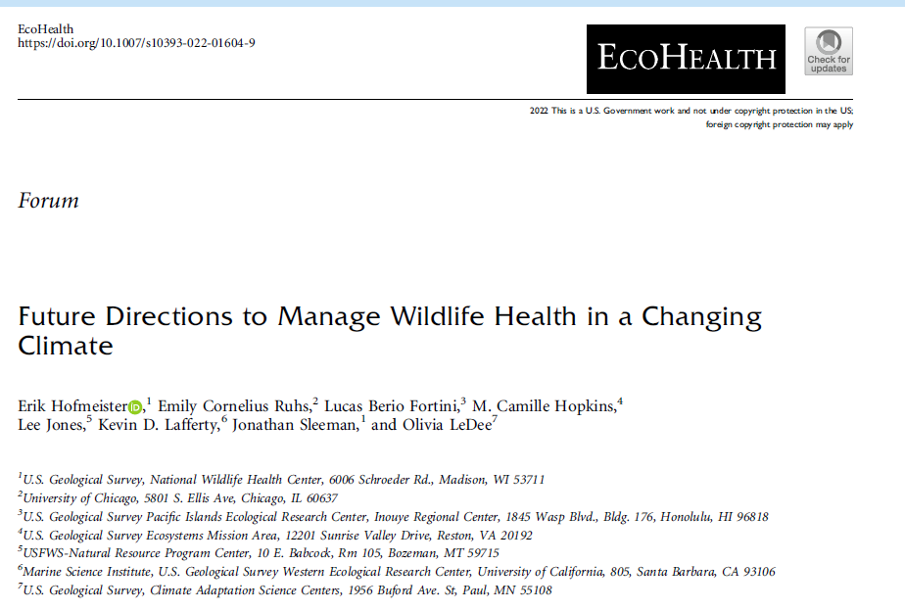
Wildlife Health in a Changing Climate
Manage for Wildlife Health, Not Disease
Conduct Systematic Health Surveillance
Implement Climate Adaptation Strategies
Implement a Systems Approach
GEERU 20240521
Notes:
USGS held a national workshop in January 2020 to identify knowledge gaps and potential adaptation strategies to limit the negative effects of climate change on wildlife health. Key points from our publication in Ecohealth are shown here. We are already seeing impacts of climate change on ectotherms, including warming waters and temperature-driven disease outbreaks for fish.

Slide 18
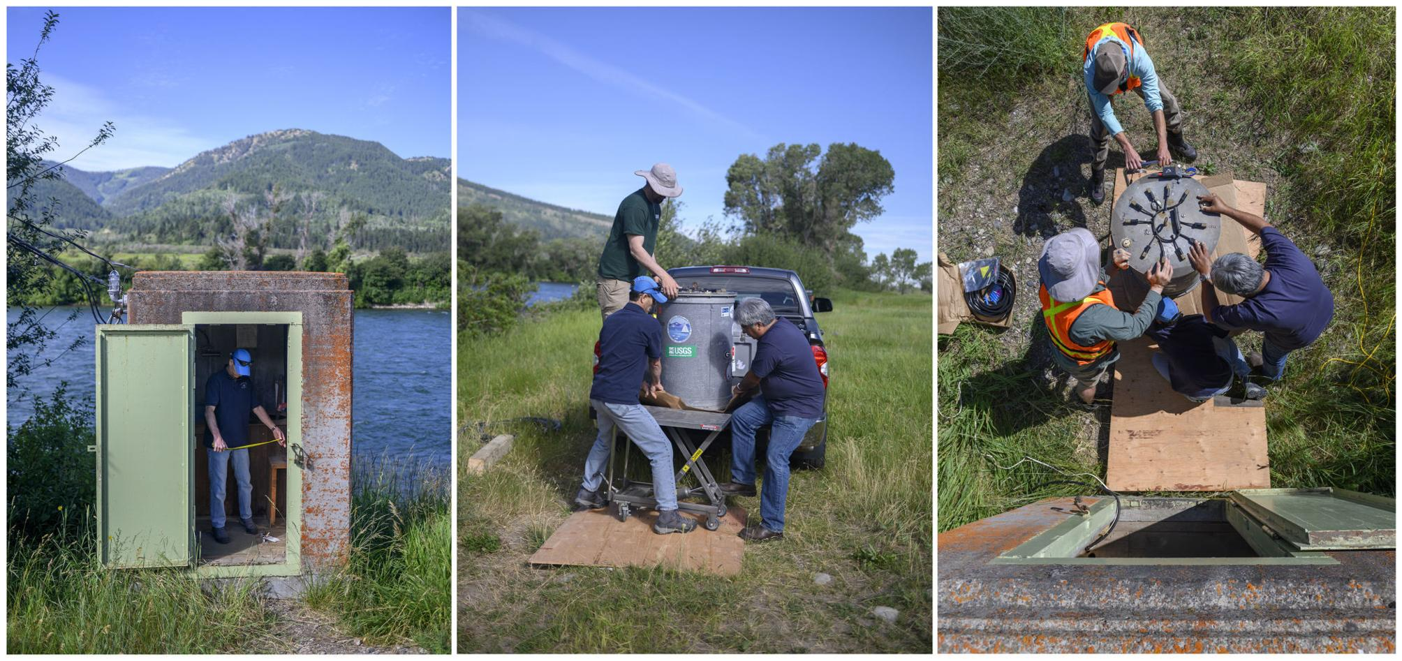
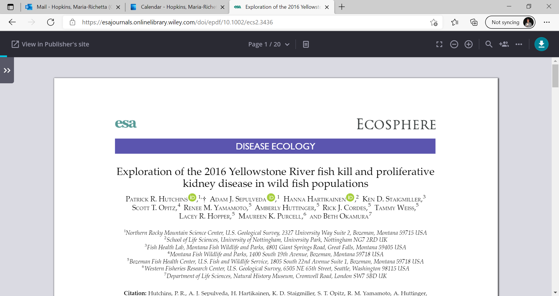
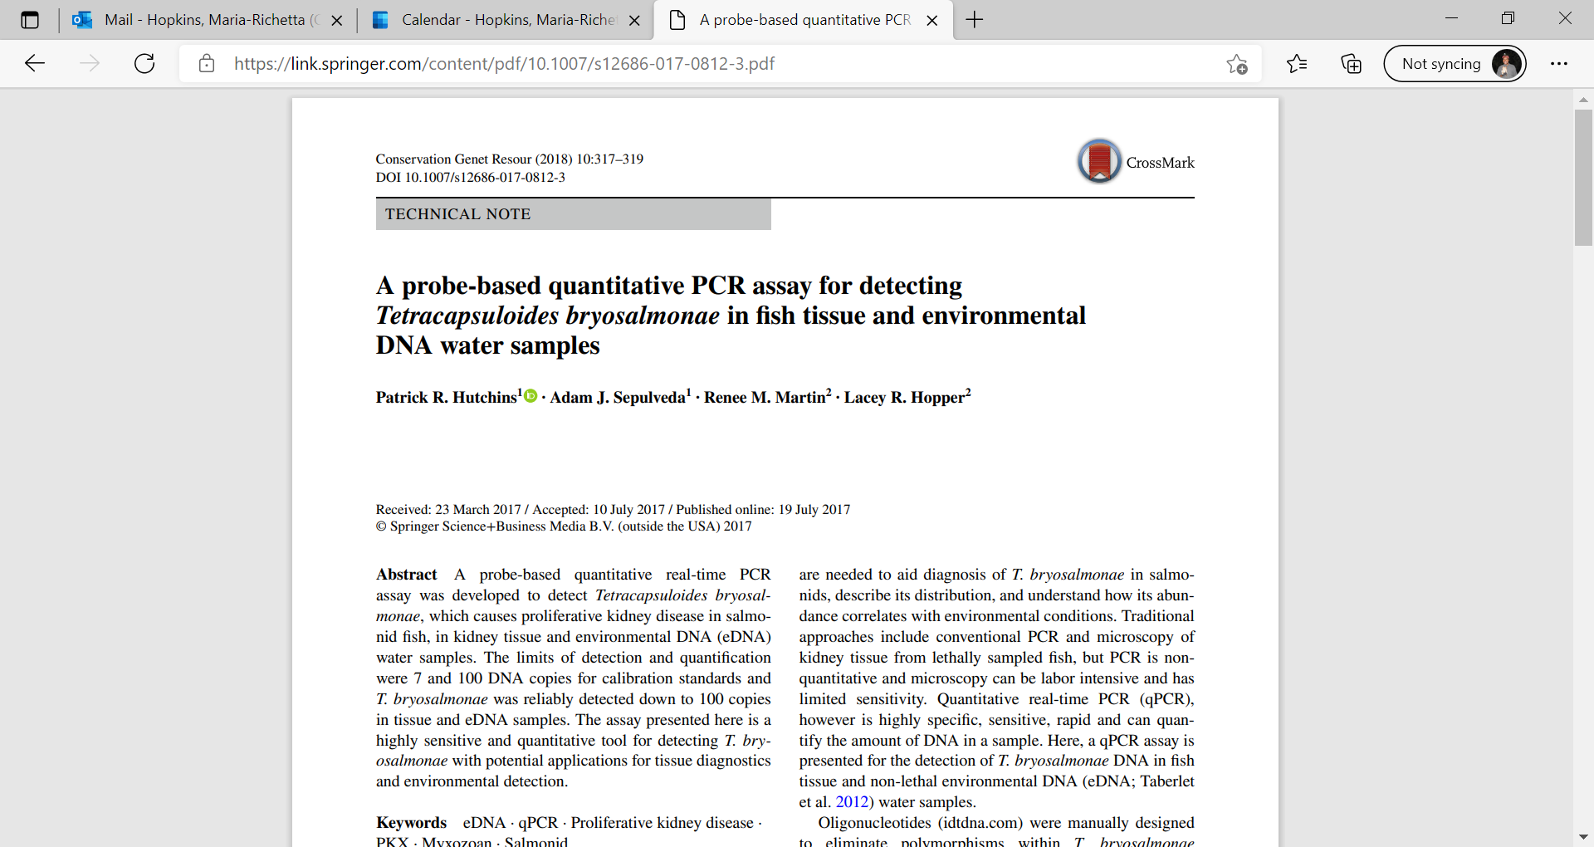
Proliferative Kidney Disease Myxoxoan parasite: Tetracapsuloides bryosalmonae
GEERU 20240521
Notes:
(CLICK!) In 2016, a fish kill led to an unprecedented decision by the state of Montana to close a total of 295 km of the Yellowstone River and its tributaries to all recreational activities for several weeks. This closure resulted in the loss of an estimated USD$500,000 to local businesses, which comprise a thriving river-based recreational economy. USGS investigated this and other die-offs with partners and then developed field eDNA testing methods and refined laboratory techniques to survey for this parasite (Hutchins and others, 2018). Field sample collection included the innovative utilization of a robotic environmental sample processor (Sepulveda and others, 2020). These efforts led to collaborative research efforts on this parasite that impacts fish not only in the US about around the world.

Slide 19
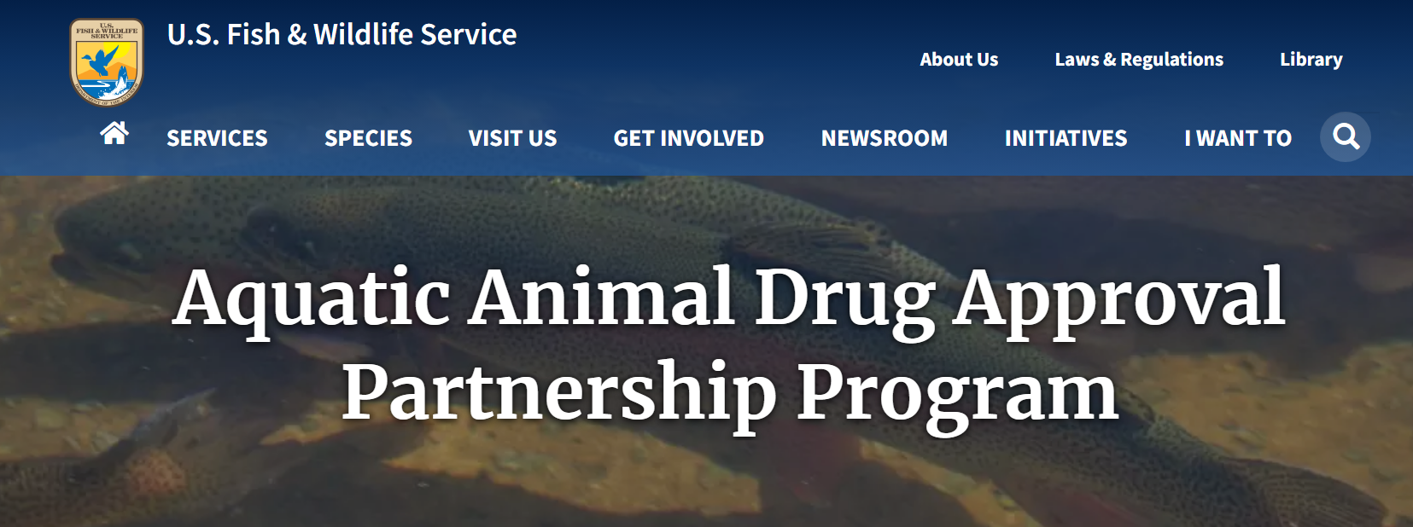
Captive Fish Health
GEERU 20240521
Notes:
USGS science supports captive fish health management forUSFWS, state, and tribal partners who have wild fish or other aquatic organisms in hatcheries. One of the challenges is developing and applying approved drugs for these minor species. There are definitely opportunities for ARS to collaborate with USGS on diseases shared by farmed and wild fish.

Slide 20
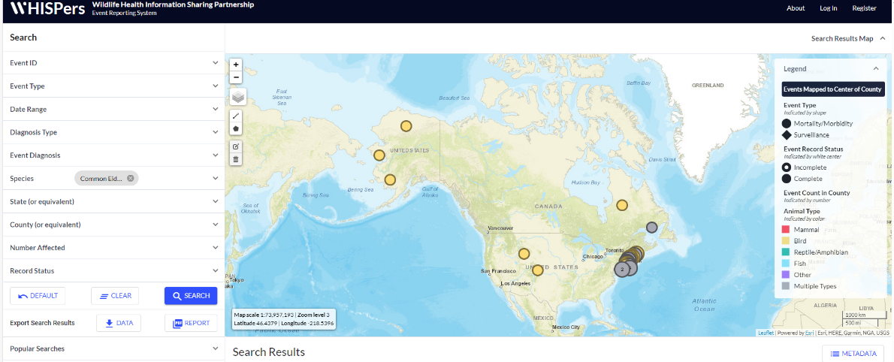
National Wildlife Disease Database
GEERU 20240521
Notes:
Whether we are talking about shared diseases with agricultural animals or people, USGS can collaborate with USDA to enhance situational awareness through data-sharing.With funds from ARPA, USGS is supporting USFWS in their Congressional directive to develop a national wildlife disease database. This will include enhancements to WHISPers, a primarily terrestrial wildlife disease databased curated by our NWHC.

Slide 21
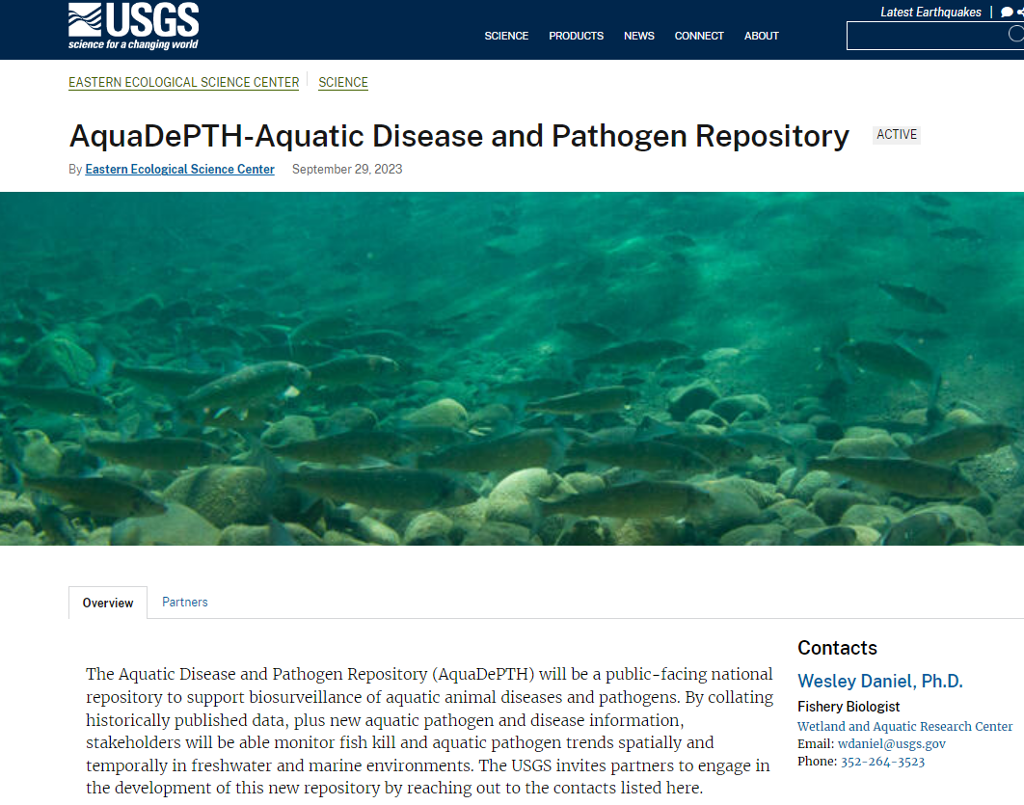
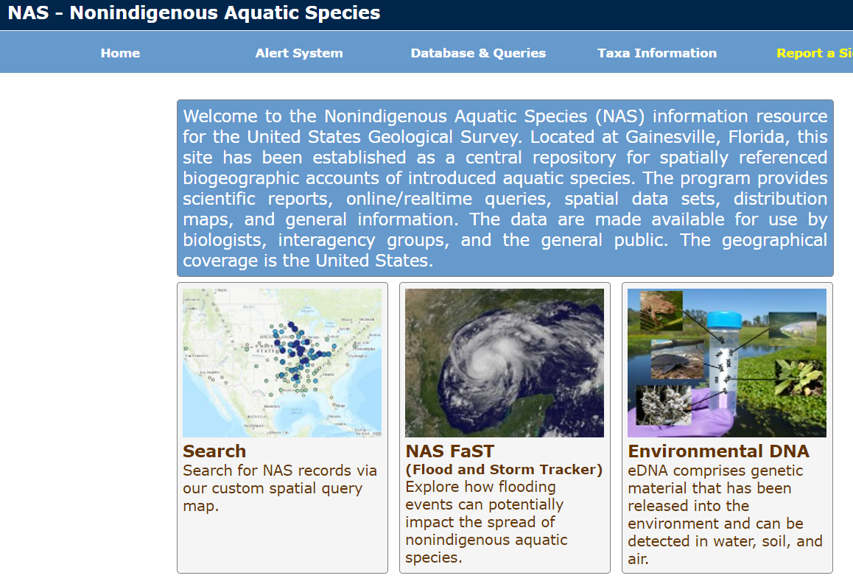
National Wildlife Disease Database
GEERU 20240521
Notes:
For the aquatic realm, USGS is well-known for its nonindigenous aquatic species database (NAS). We are in the process of developing a new database that builds off of NAS (CLICK!) - The Aquatic Disease and Pathogen Repository (AquaDePTH) will be a public-facing national repository to support biosurveillance of aquatic animal diseases and pathogens. It willBy collating historically published data, plus new aquatic pathogen and disease information, stakeholders will be able monitor fish kill and aquatic pathogen trends spatially and temporally in freshwater and marine environments. The USGS invites partners to engage in the development of this new repository by reaching out to the contacts listed here.

Slide 22

USGS “I am A …” Series: Disease Ecologist www.usgs.gov/media/videos/i-am-adisease-ecologist
Thank you!
All photos are from USGS and the public domain unless otherwise credited

